Slide 1
Girls Who Code WashU
Spring 2018
Virtual GBM

Slide 2
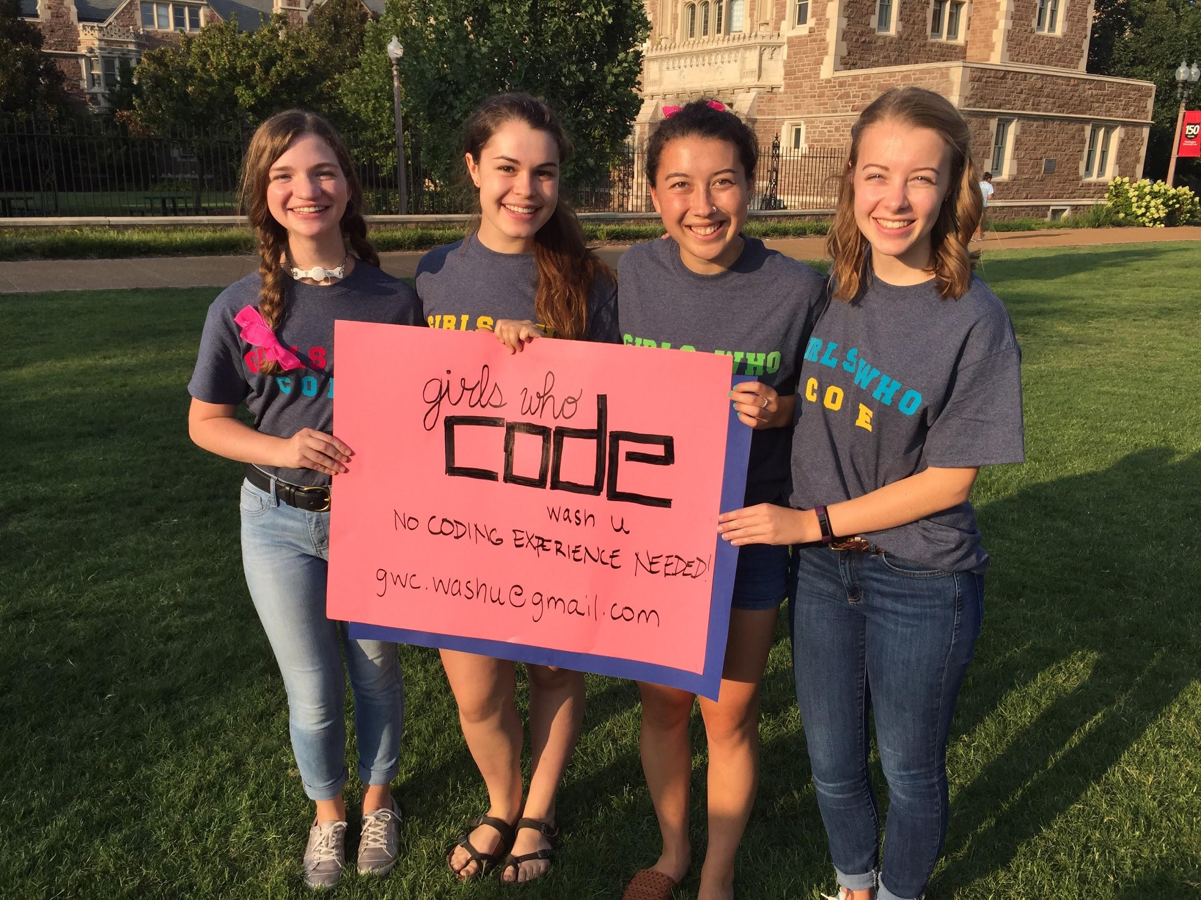
Who We Are
Wash U’s chapter of the national nonprofit organization, Girls Who Code
Brand new club (second semester in operation!!)
Started after hearing a presentation from GWC founder, Reshma Saujani in the Spring of 2017
Current executive members (from left to right): Katie Doderer, Charlie Brickner, Maya Coyle, Emily Wilson, Kristine Ehlinger (not pictured), and Kelly Jung (not pictured)

Slide 3
What We Do
Teach middle and high school-aged girls basic coding techniques and programs
Promote collaboration and strong female friendships/mentorship/sisterhood, both among our club participants and our club members/facilitators
Hope to close the overwhelming gender gap in STEM careers by focusing on sparking the interest of younger generations and building girls’ confidence
Work on real world problems and create impactful solutions
Learn more about the Girls Who Code mission at https://girlswhocode.com/

Slide 4
Our Clubs
Starting this semester, we will begin working with girls from the local community on the national Girls Who Code curriculum. We will also be accepting new members (that’s you!) and helping them become familiar with the GWC curriculum and with our clubs. In addition, we will continue recruiting girls from the community to participate in our clubs, spreading the word about GWC, fundraising, and more!
We have two locations, one on campus at WashU and one at the KIPP middle school, KIPP Triumph. Each location will have one session per week. KIPP clubs will meet on Friday afternoons from 1-3pm and Wash U clubs will meet on Saturdays from 9:30-11:30am.
We are working to start more clubs in the area this semester, and are hoping to have those clubs established by the Fall 2018 semester.

Slide 5
What You Can Do
Facilitate: Want to do work with our club members directly? Be a facilitator.
Responsibilities:
Show up for weekly club meetings that you are signed up for
Work one-on-one with girls
Be positive! This is really your only job - to encourage and support the girls in their project aspirations.
Advertise/Recruit: Don’t want to code at all? Help us spread the word.
Responsibilities:
We need people behind the scenes so that our facilitators can focus on the curriculum. Which means we need help recruiting middle and high school girls from local schools.
We want to spread the word about GWC and about our mission of closing the gender gap. Which means we also need help with advertising/fundraising/social media/etc.
Weekly meetings with sub-committees that focus on different aspects of GWC WashU.

Slide 6
The Application
The application process consists of:
A written application (Google form)
Possibly an interview with one of the exec members if we have further questions
We are hoping to fill roles beyond just facilitation:
Recruitment/outreach
Advertising/marketing/social media
Training members
Any other skill you think you might bring
As a new club, we are open to ideas for how to be successful! Feel free to reach out to us with any suggestions or questions.

Slide 7
Time Commitment
What to expect:
Monthly General Body Meetings for WashU members
Weekly or Bi-Weekly 1 hour meetings with our local girls (plus transportation time if applicable)
If you are a GWC WashU active member, we expect you to show up for facilitating sessions you are signed up for (if you decide to become a facilitator). We also expect you to come to General Body Meetings unless you have a significant excuse. Basically, we expect you to show up to stuff you commit to!

Slide 8
WE ARE SO EXCITED TO HAVE YOU!
We have had so much interest in this club already, and we are only just getting started! We can’t tell you how much that means to us, because we know our mission is an important one.
If you think so too, APPLY! We want to know who you are and why you want to help.

